Slide 1

Corona virus analysis
Using MySQL query
Name: Saravanan R
Date : 10/06/2024

Slide 2
AGENDA
Introduction
Data Preprocessing
Query Results
Date Range and Monthly Data
Summary Statistics
Regional Analysis
Conclusion

Slide 3
INTRODUCTION
OBJECTIVE: Analyze COVID 19 data to extract meaningful insights. Gaining insight into pandemic impact through Corona virus dataset.
DATA SOURCE: Coronavirus dataset.csv
TOOL USED: MySQL

Slide 4
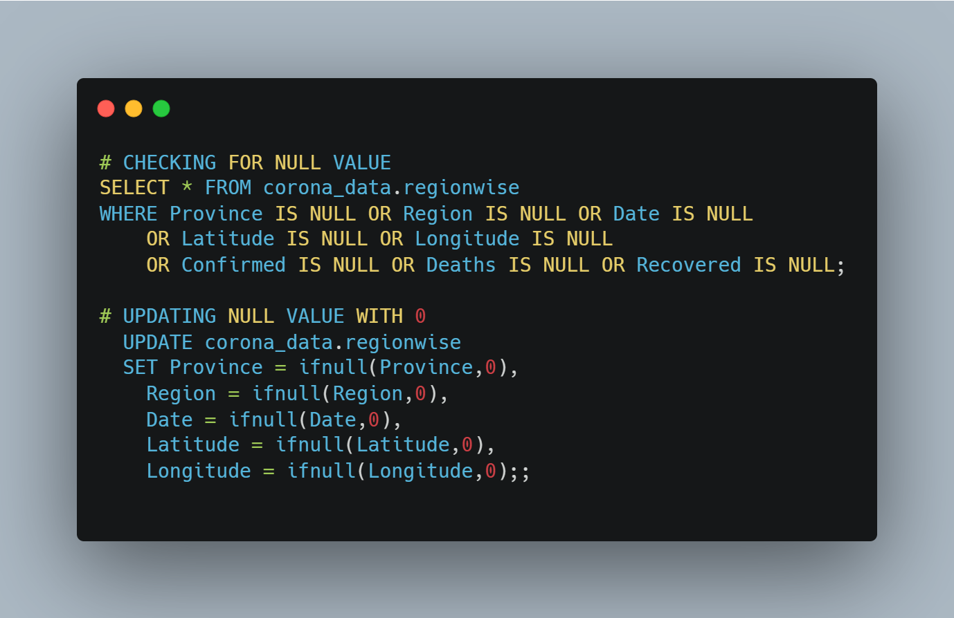
DATA PREPROCESSING
Checking the data by checking for null in data and replace with 0.

Slide 5
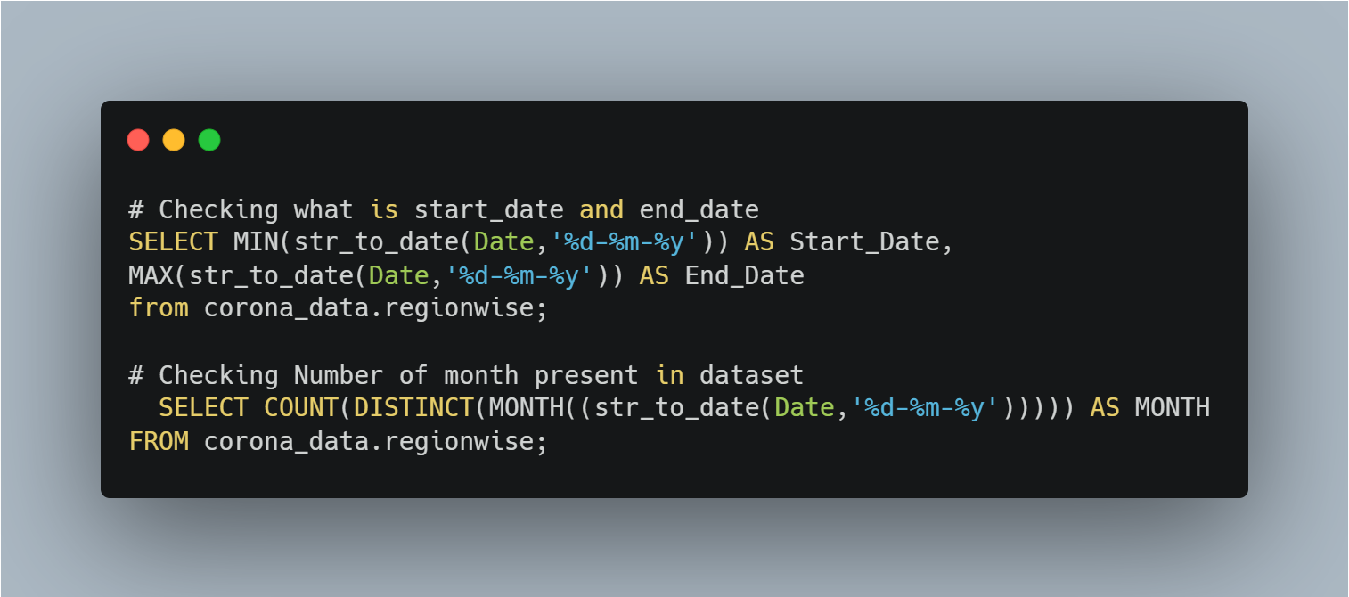
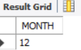
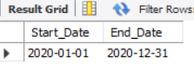
Date Range and Monthly Data

Slide 6

Monthly Summary Statistics

Slide 7
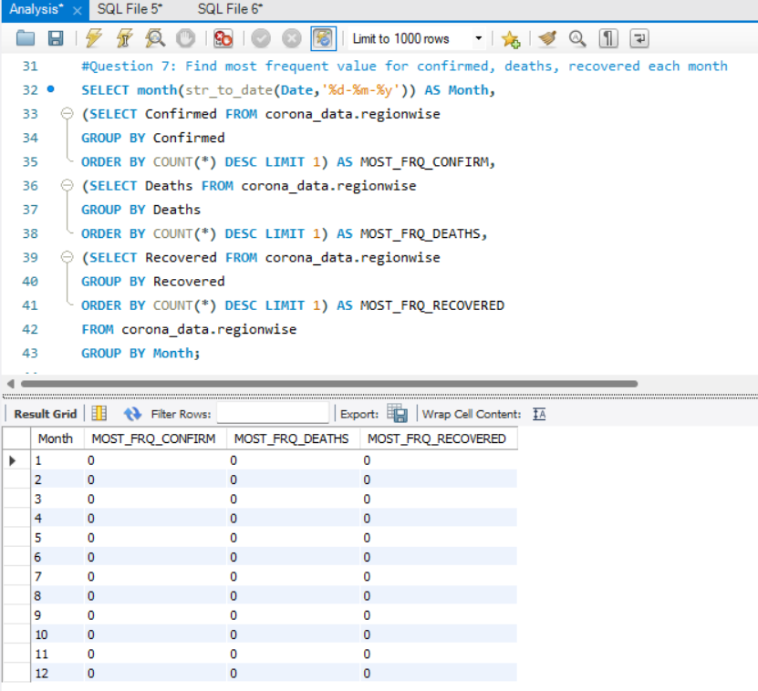
MOST FREQUENT VALUE EACH MONTH

Slide 8
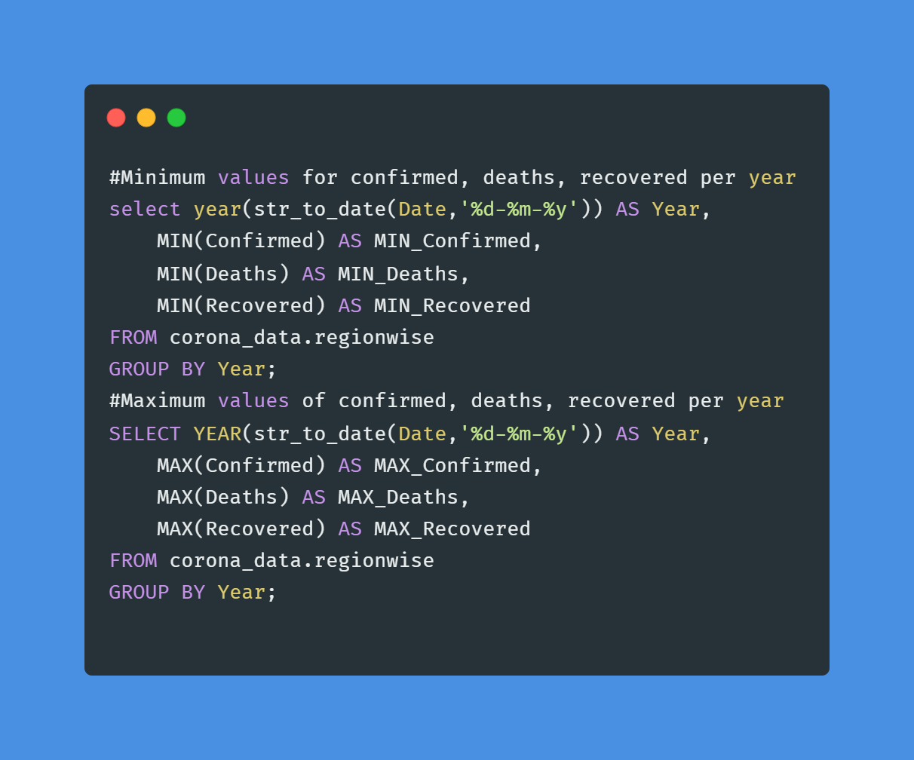
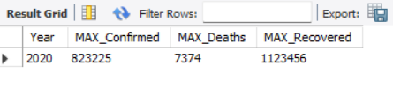
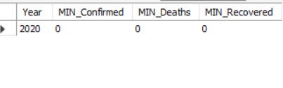
Yearly Summary Statistics
Minimum and Maximum values for confirmed, deaths, recovered per year

Slide 9
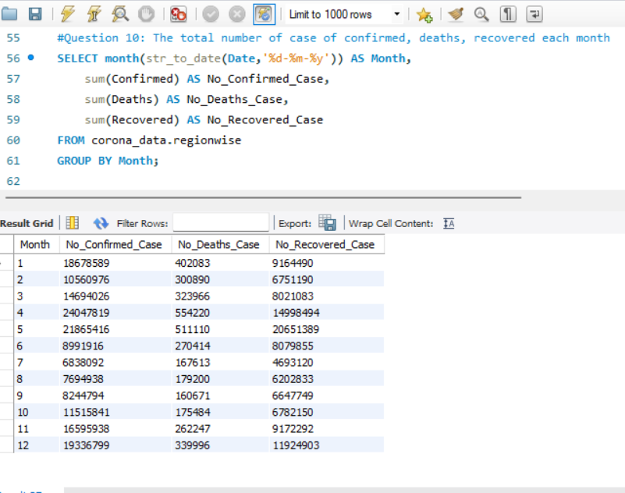
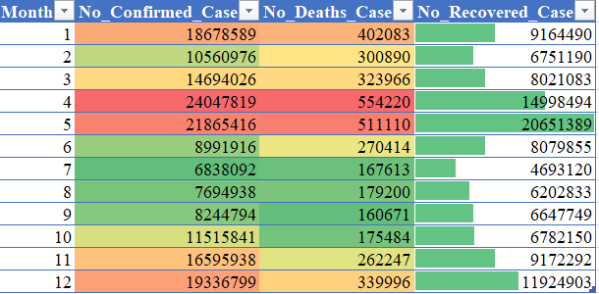
The total number of case of confirmed, deaths, recovered each month.

Slide 10
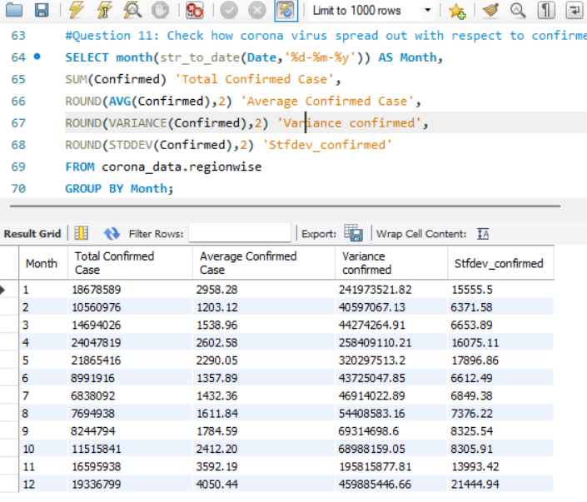
Corona Virus Spread out
Checking how corona virus spread out with respect to confirmed case each month

Slide 11
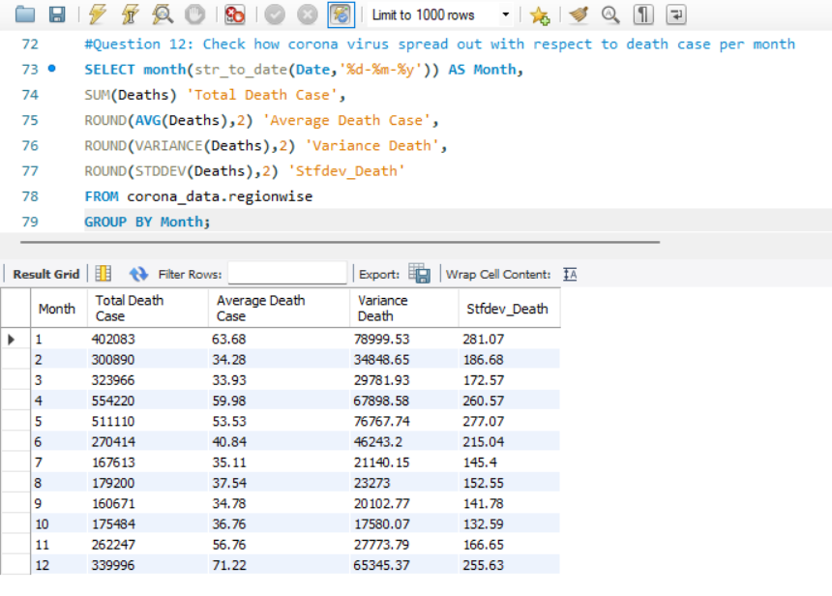
Checking how corona virus spread out with respect to death case per month

Slide 12
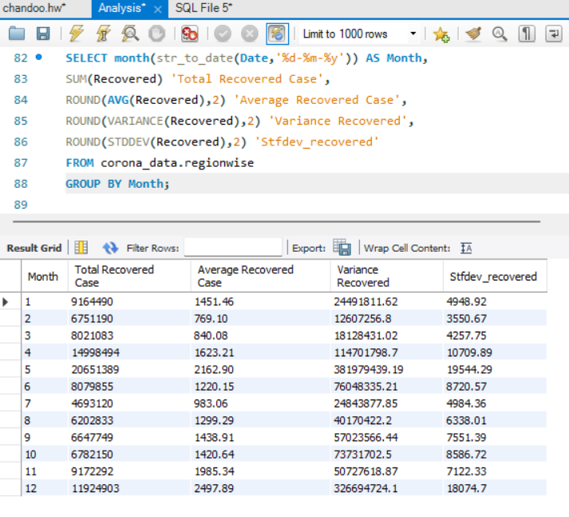
Check how corona virus spread out with respect to recovered case per month

Slide 13
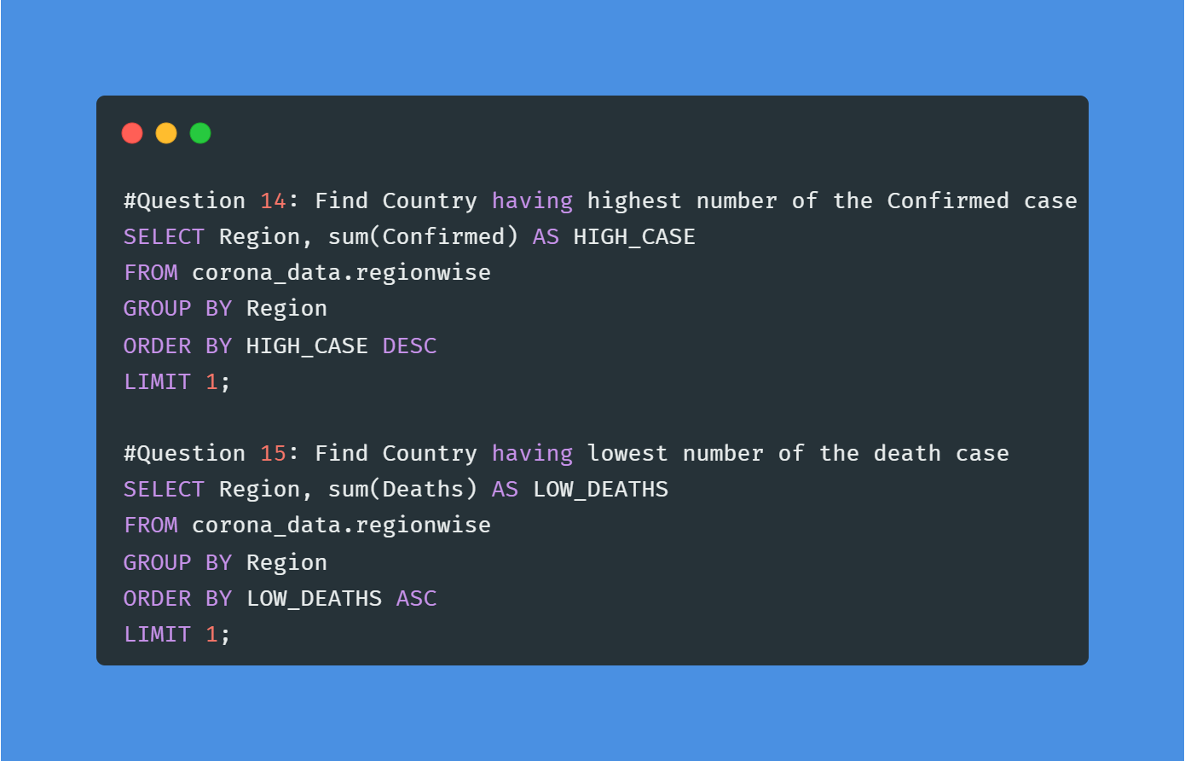
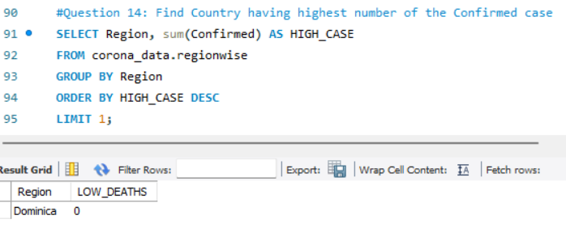
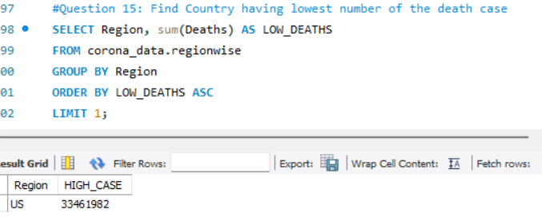
Region wise Analysis
Finding which country has a maximum confirmed case and minimum deaths.

Slide 14
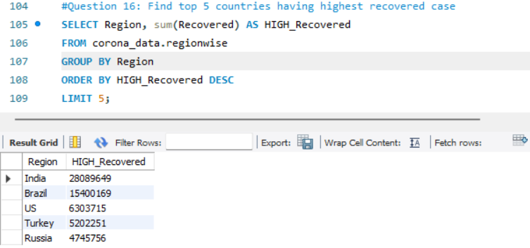
Top 5 Country which has maximum recovered cases from COVID-19 2020.

Slide 15
Conclusion:
In Year begin and end of 2020, number of cases were increased and in Mid year it gradually decrease.
In Starting of year, COVID 19 gradually increase and peak at month of April and May, Afterward gradually decrease at month of June, July and August, September and increase linearly at month of October and peak at End of the year.
Europe region affected most followed by US region.

Slide 16
Question & Answers Thank you

